Slide 1



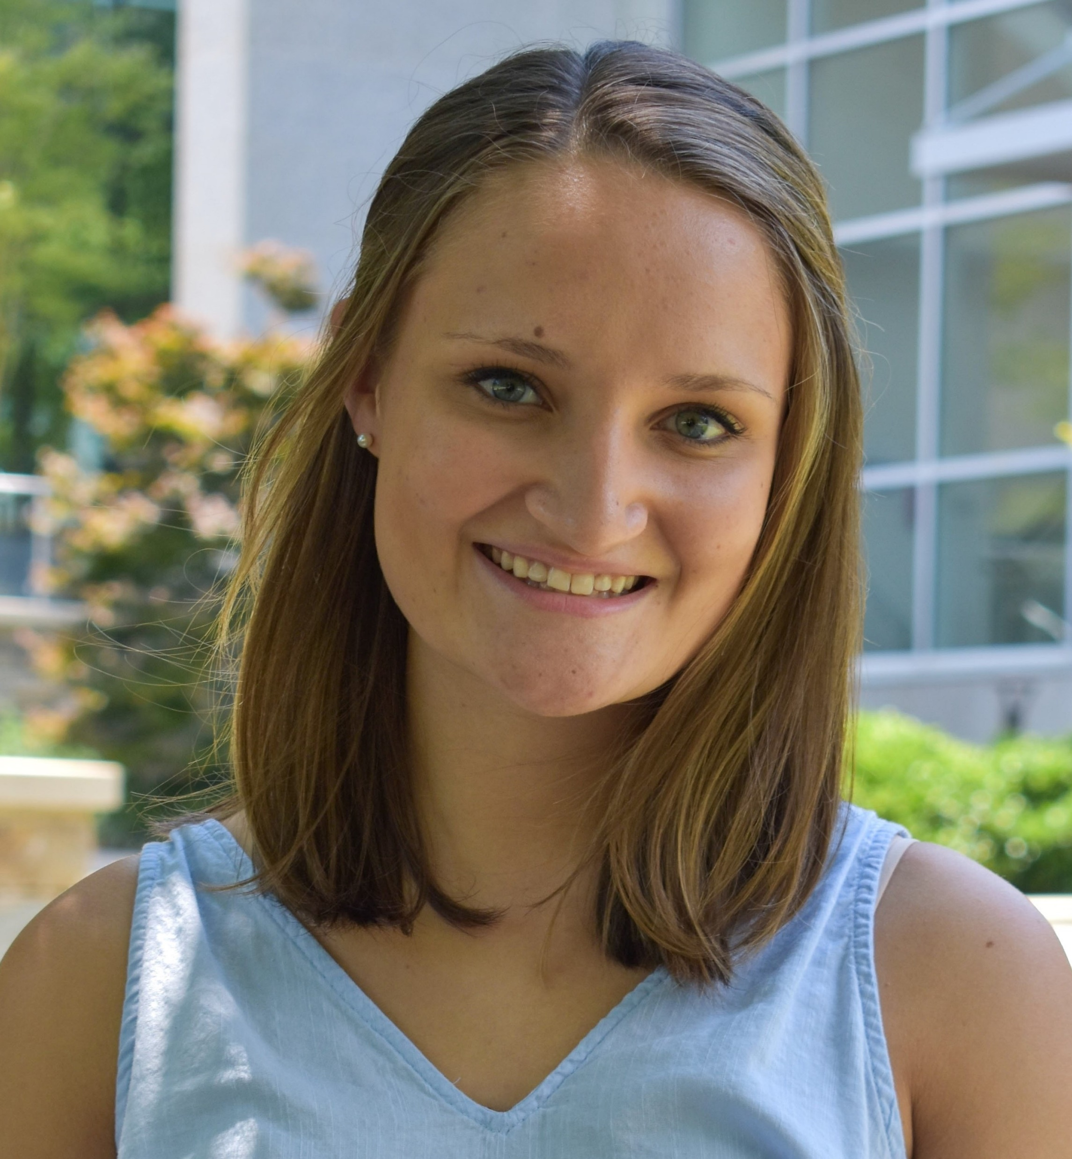

Laura Federline – Health and Life Sciences R&D
About Me
Major: Statistics, minoring in Biological Sciences
Graduating November 2020
Fun Facts: Pack Clogging member, studied abroad in the Czech Republic
3rd summer at SAS
Ask me about my Previous Projects
___
Intern Hack-For-Good event
Served as an intern virtual lunch leader
Published data stories on GatherIQ
Obtained SAS Certified Specialist Certification
Statistical analysis of top diseases in the US
Data Visualization Techniques for Communicating Long-Term Trends of Diabetes
This Summer’s Project
Analysis of Semi-Structured Text using WHO COVID-19 Situation Reports
Logistics for Presentation
I will start my presentation at 10 past the starting time (8:40am; 10:25am; 11:25am) to allow employees to enter the breakout rooms.
All questions will be held until the end of the presentation. Please use the chat if you’d like to send questions in advance.
Notes:
Okay it is about 8:40, I’m going to go ahead and get started. Welcome everyone! Thank you for attending the intern expo. I am so excited to share what I’ve been working on this summer!
I am Laura Federline. I go to NC State and I am graduating this November. and I am majoring in Statistics with a minor in biology. Some fun facts about me is I am on the Pack Clogging Dance team at NC State and I studied abroad in the Czech Republic earlier this year.
Here at SAS, I am currently a year-round intern in Health and Life Sciences R&D. This is my 3rd summer at SAS. You can read through some of the other things I’ve gotten to work on during my time here. If any of those interest you feel free to connect with me after the expo.
So now I’m going to dive into my summer project, if you have any questions or comments throughout feel free to throw those in the chat and I will answer those afterwards.

Slide 2
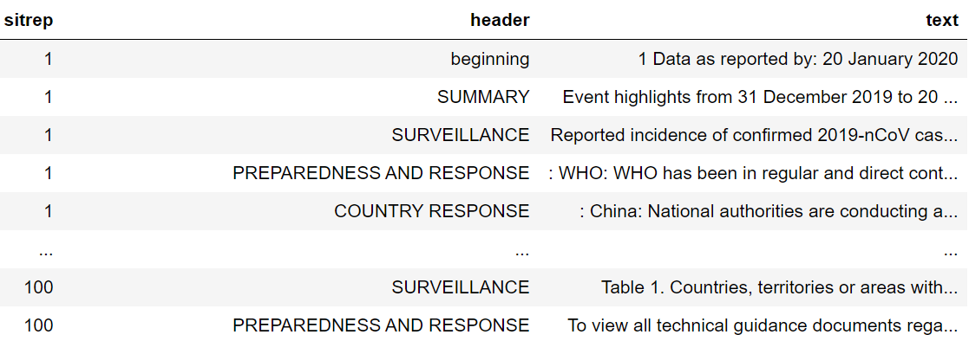
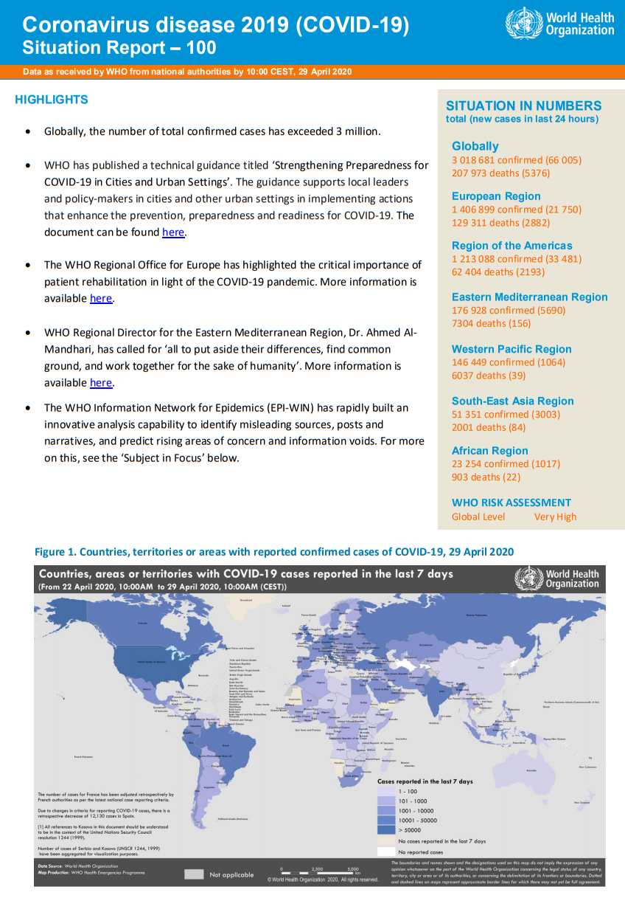
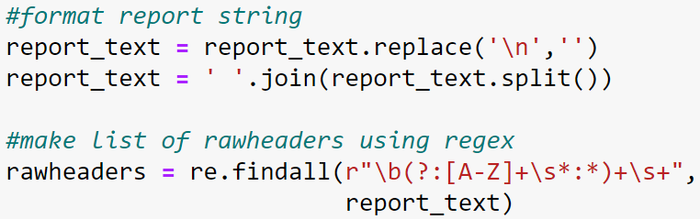
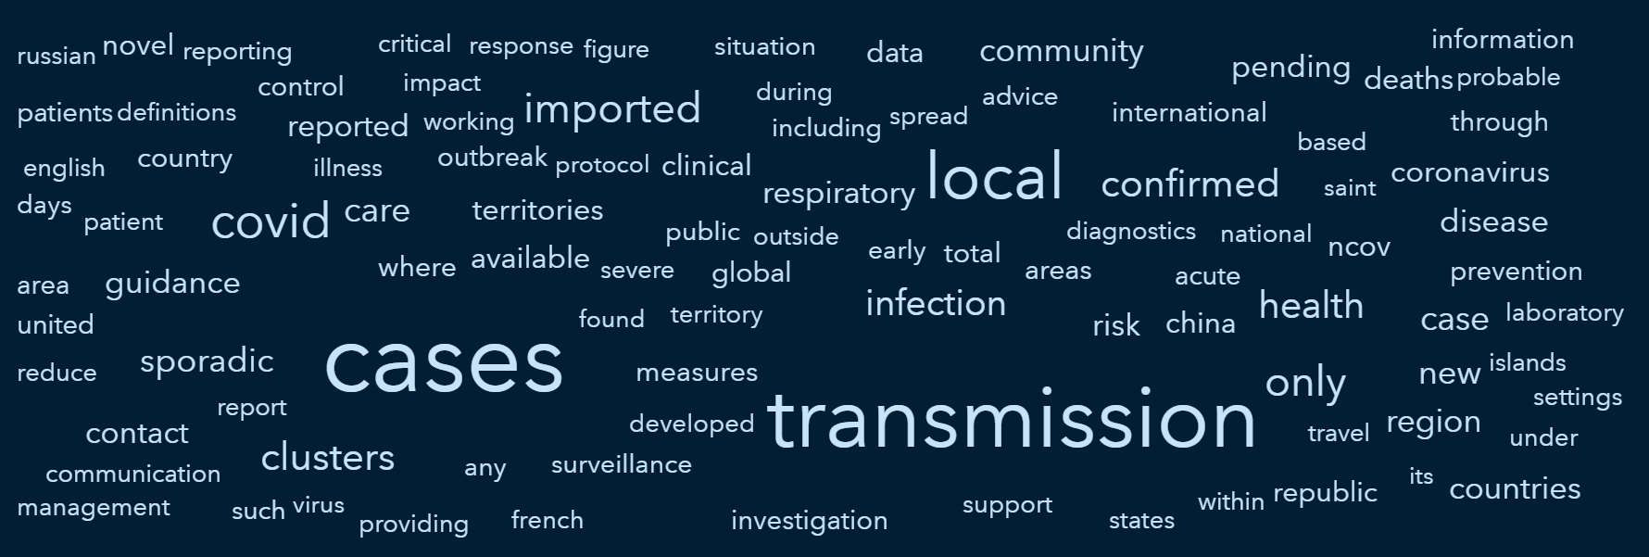
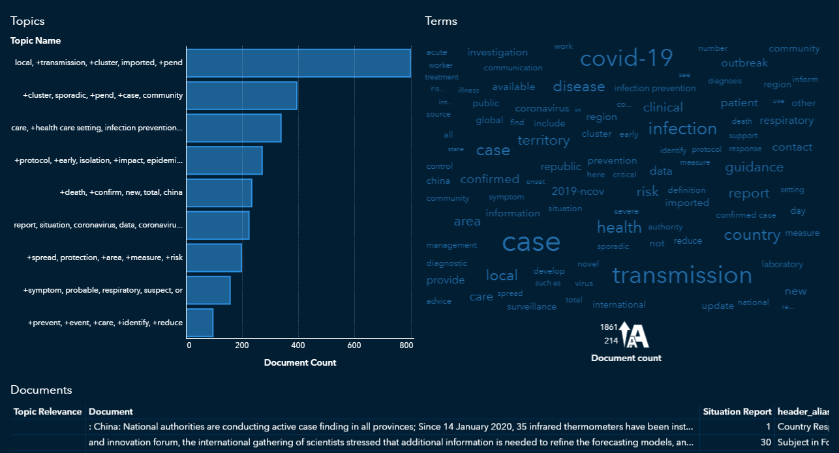
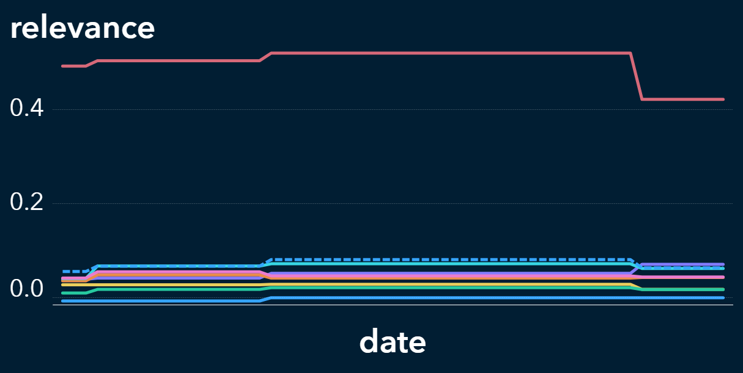
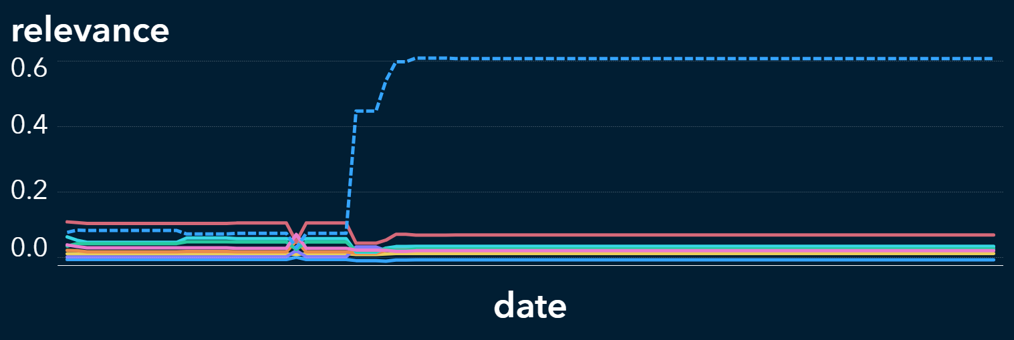
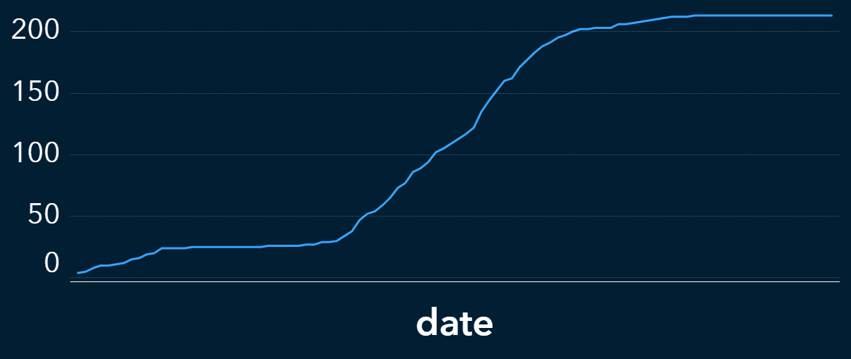
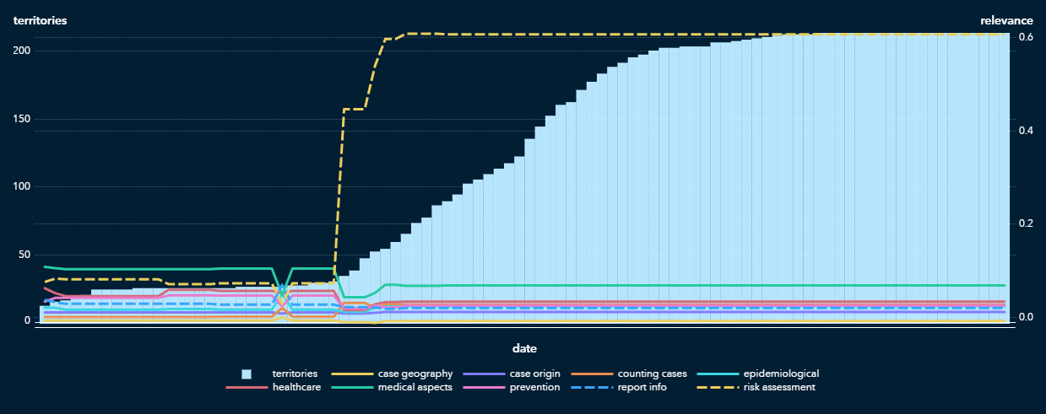
Laura Federline – Health and Life Sciences R&D
Analysis of Semi-Structured Text using WHO COVID-19 Situation Reports
Text Origin
___
Data Preparation
Background
The WHO releases daily situation reports on COVID-19. This project focuses on the first 100 reports released January 21st – April 29th.
Report Structure
Published as a PDF
100 reports
916 pages total
312,831 words
Semi-structured (deliberate structure & text separable by headers)
1. Python
Project Goals
Quantify changes in language and content
Identify advisory themes
Evaluate the degree to which these reports reflect current data
snippet of Python script to extract & format text using PYPDF2 package
resulting text data structure
2. SAS Studio
3. Visual Analytics
Separate text into smaller units of observation
Add descriptor variables and COVID statistics (e.g. death count)
Clean text further to prepare for analysis
word cloud of most frequent words
Explore text contents with VA objects and adjust data in SAS Studio.
screenshot of 100th PDF
Text Topics object in Visual Analytics
Text Analysis
Content Change of ‘Case Definition’ Section
Emphasis Change of ‘Advice and Recommendations’ Section vs. # territories with COVID cases
# territories
change in wording
“contact” definition added
“COVID-19 death” definition added
At the same time territories (bars) began to increase, the ‘risk assessment’ topic (yellow line) became dominant in ‘Advice and Recommendations’.
9 text topics with little overlap were derived. Each text document is assigned a relevance for each text topic.
Each line represents a topic. Stagnant time periods indicate that the Case Definitions were identical between reports.
Notes:
This summer, I have been working on a project that demonstrates how text analytics can be used to understand large amounts of content released about COVID-19. As we all know, a lot of information and research has been released on this topic at a really fast rate and there is a lot for us to parse through and keep up with.
I’ll be showing how text analytics can help in summarizing and understanding large amounts of text as well as bring patterns to light that may not have been found otherwise
I’ll be going over where the text for my analysis comes from, how I prepared this text, and the results from my analysis.
*ZOOM IN*
Text Origin
The text that I used for my analysis comes from the situation reports released by the WHO
These are released daily, and are still being released, released one today
Mine is 1st 100, this covers time period from January 21st – April 29th
Report Structure
*poster*
-I’m telling you this to give an idea of just how much information the WHO published and how much text there is to read
-The text is semi-structured- which means the authors of these reports have a deliberate structure and content in mind. To an extent, we know what to expect from these reports. This is much different than analyzing say, Twitter data, since there is one organization writing this text and they follow a set of guidelines. Also, all of the text falls under a header which allows the text to be categorized in a way which will be helpful later on
-Screenshot of one of the pages to give you an idea of what they look like
-They are just like they sound – provide the most recent situation for coronavirus all over the world, including things like highlights, focus subjects, recommendations, and a lot of other important info
Project Goals
First things first, in order to do a text analysis we need data. I needed to extract all of the text from all 100 PDFs while retaining information about which report and section the text came from.
Data Preparation
The first step in my Data Preparation was to write a Python script using the PYPDF2 package
-This is a really useful tool to automatically extract text from PDFs in a really efficient way
-And this script is also where I did a little bit of formatting to get a data structure
Next, I imported this data into SAS Studio
-this is where I created all the data structures I would need for analysis
-I did things like separate the text into smaller units of observation as well as add variables that will be useful later on
-And lastly, I needed to clean up the text. So the next step was an iterative process between SAS Studio and VA. VA was used to explore the contents and check for any nuances in the text which I would then go back to my code and fix these issues
So now that the data is ready for analysis, we can start learning about the text. I’m going to show a couple screenshots to give an overview of the results I found and then show a live demo.
Text Topics
This is a screenshot of the text topics object in Visual Analytics
Text topics are what I use for my entire analysis
What is a text topic?
A text topic is essentially a set of terms with different weights
-Used to identify themes in text
-Really useful in quantifying the content in text and these will allow me to analyze their change over time
-
Each text doc is assigned a relevance for each text topic
This relevance represents to what extent does that topic represent the text document
This is helpful in identifying content change and even emphasis changes
Content Change
-This is an example of how the relevance values can be used to identify content changes
-*explain graph*
-So whenever there is a slight change in wording or any addition to the text, no matter how small, the relevance values shift.
-stagnant time periods are identical
-user only has to read 4 reports to read every single word WHO wrote on this section
Emphasis Change
-similar graph, addition of stat
-inflection point is where emphasis change occurs
-WHO is adjusting their message according to the current data

Slide 3
DEMO

Slide 4
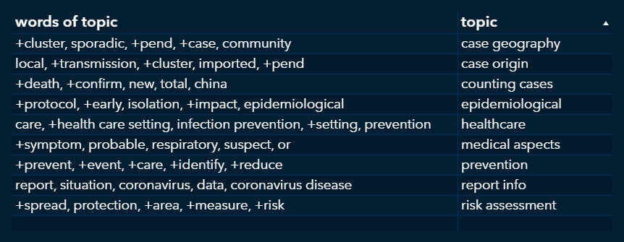
Laura Federline – Health and Life Sciences R&D
Takeaways
Topics found in Text
case geography
counting cases
prevention
epidemiological
risk assessment
medical aspects
healthcare
case origin
report info
Use of this Project
Know content without having to read
Ex. ‘Advice and Recommendations’ do not change after report 42
Identify advisory themes
Identify patterns in content change and COVID trends
Contact Information
SAS email: laura.federline@sas.com
College email: lefederl@ncsu.edu
https://www.linkedin.com/in/laura-federline/
Notes:
Reiterate uses of project
If you have any questions feel free to ask them now, otherwise thank you so much for listening!

